Slide 1
Nyc doh ratings
Group 7: Emma Pang, jenny yi, Lauren McKinzie, Regana Alicka, Steve Li

Slide 2

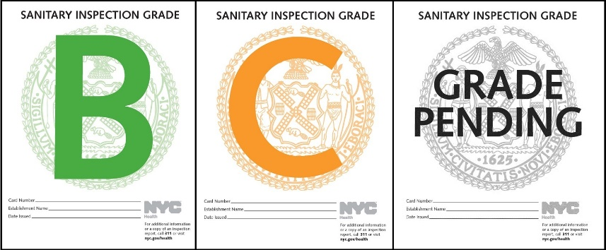
RESEARCH APPROACH
CONTEXT
The Department of Heath (DOH) is responsible for conducting restaurant health inspections on all food-handling, food-service establishments in NYC.
A restaurant’s score corresponds to a letter grade. The lower the score AKA the less violation points, the better the grade.
OBJECTIVES
Using the DOH’s public data on restaurant violations and grades, we were able to answer:
How many restaurants have A, B, C ratings? And where are they?
Is there a specific area in NYC with a higher concentration of a rating?

Slide 3

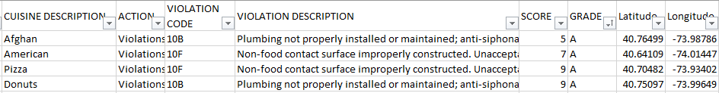

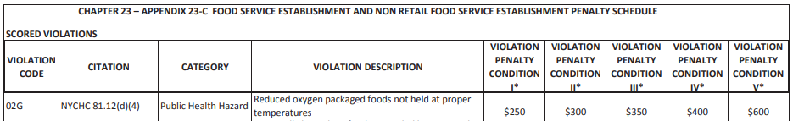
Data sources
1. March 2020 NYC Restaurant Inspection Results 430K Rows, 26 Columns
2. DOH Violation Penalty Dictionary
Notes:
Those >50YO are more likely to dislike rigid fabric and wide leg.

Slide 4
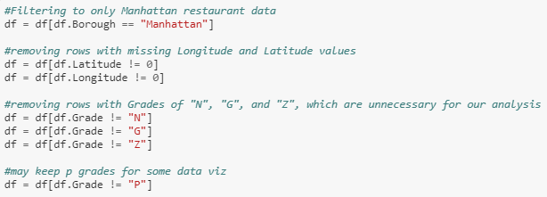
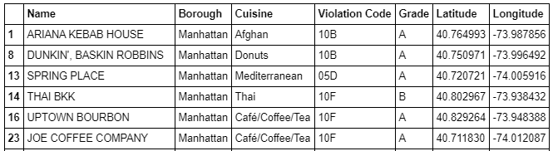
Data ETL
Because the data set was so large (167 MB), we only extracted Manhattan restaurants with A, B, or C ratings (the rest are not public facing ratings) and cut it down from 26 to 6 columns.

Slide 5
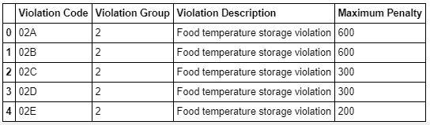
Data ETL
We also manually categorized the violation codes into more manageable buckets (food storage related, facility related, vermin related, etc.) and added maximum violation penalty fees based on the DOH violation dictionary.

Slide 6
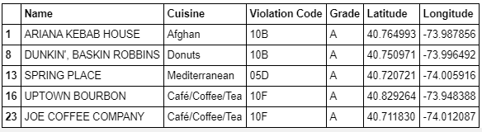
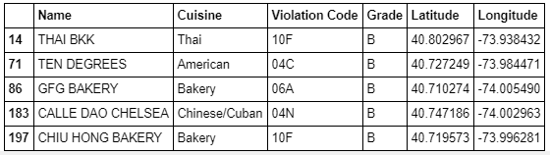
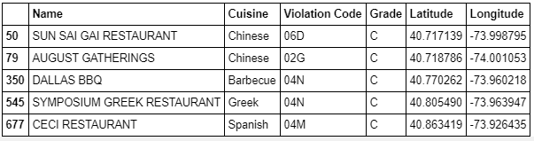
Clean Datasets
To offload the expected lag time on our flask app/leaflet map, we separated the data by their grades before uploading into mongoDB.

Slide 7
backend
Javascript description here

Slide 8
Let’s check out the front end

Slide 9
Post mortem – WOULD’VE, COULD’VE, SHOULD’VE
WOULD’VE
If we had more time, we would have figured out how to load a Leaflet map with much more data (Queens, Bronx, Brooklyn, Staten Island) and also done some interesting plot.ly charts looking into violation codes by borough.
COULD’VE
We could’ve looked at violation codes and ratings by cuisine, but didn’t want to open that Pandora box of cultural stereotypes.
SHOULD’VE
We should’ve…..

Slide 10
Questions?

Slide 11
Thank you!

